Slide 1

Water Sensor Package
Kyle Ng

Slide 2
Plan for Environmental Sensor Package
Create a datalogger for TDS sensor
Combine all the sensors into one datalogger
Design PCB to tie everything together
Design waterproof case to house all components
Test and validate

Slide 3
1/18/2022
Need to order TDS Probe and obtain a SD card and SD card reader
RTC, SD card reader, and TDS sensor code

Slide 4
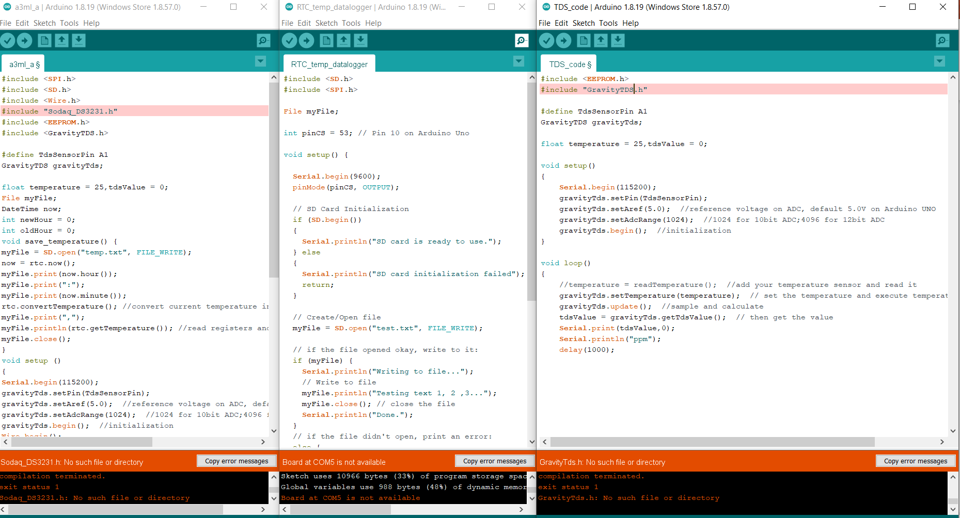

Slide 5
1/25/2022
Code for TDS sensor data logging to SD card working
Need to test code when probe arrives

Slide 6
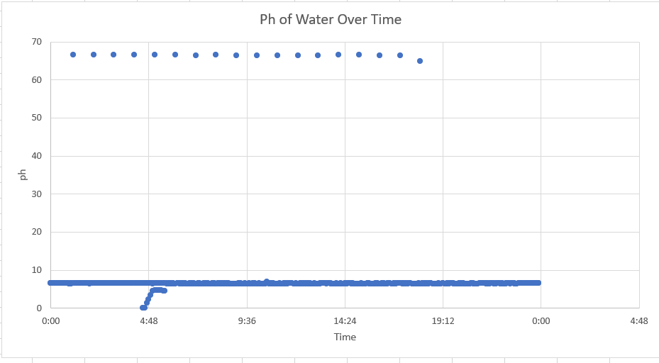
2/1/2022

Slide 7
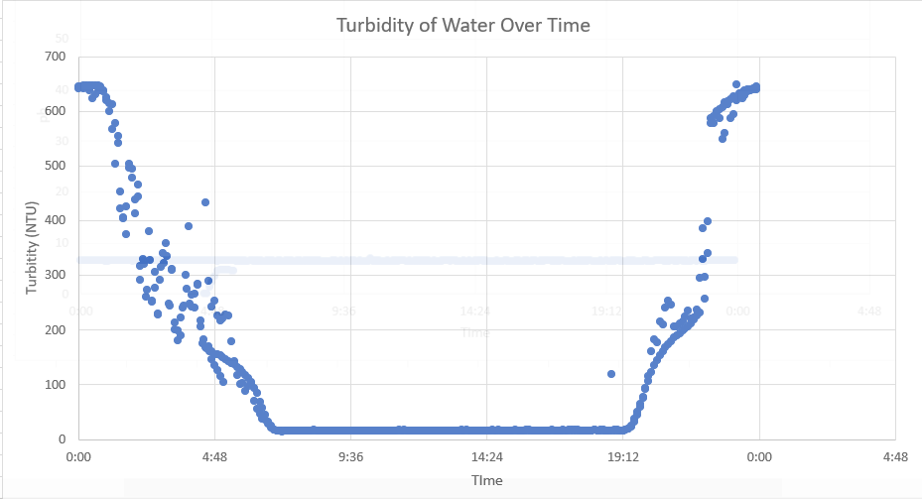
Turbidity

Slide 8
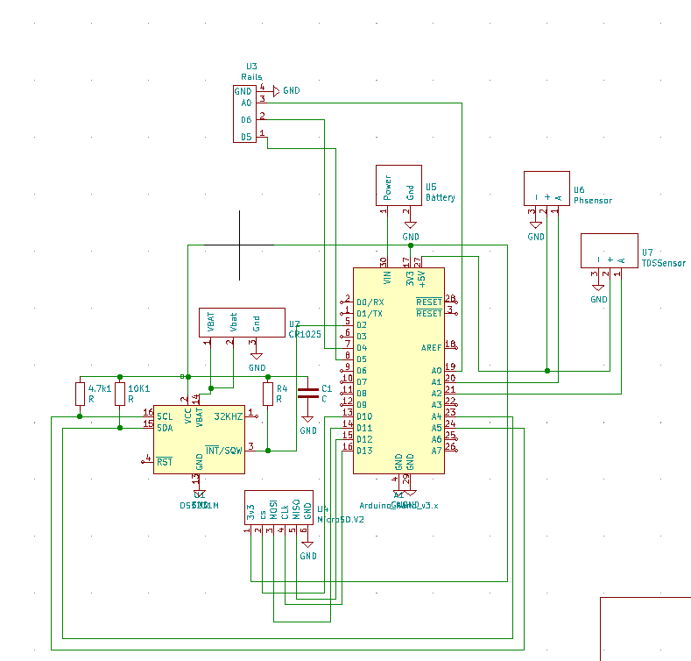
2/15/2022
Included TDS sensor into current sensor package
Next Step: rearrange components on board to fit in new housing

Slide 9
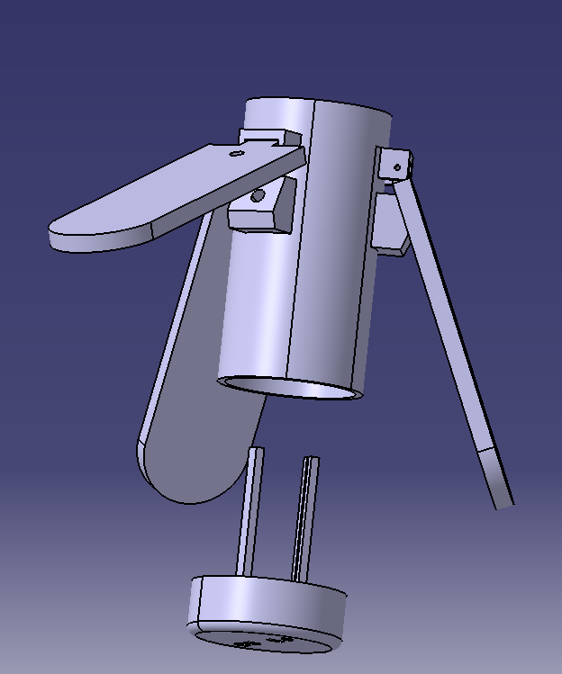
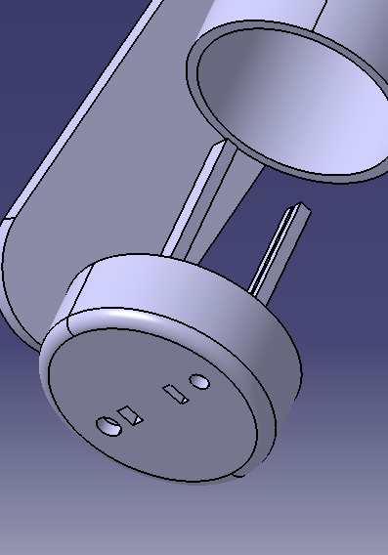
Housing for sensors
Solar flaps can be used as a tripod
Probes and sensors will fit through the bottom
PCB with components will fit between the slots in the two rails
Next Steps:
Add protection for probes/sensors on the bottom
Add battery holder to the bottom component holder

Slide 10
2/22/2022
Solar Charging Findings
TDS Testing
Updated Housing for components

Slide 11
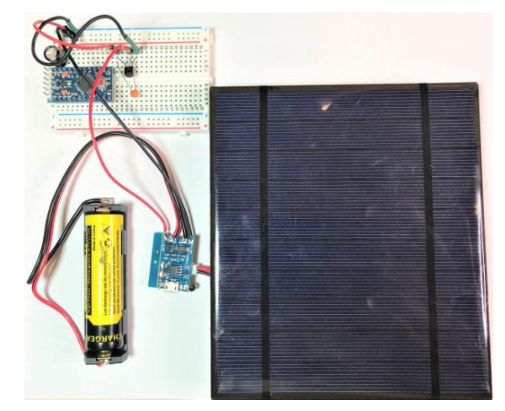
Solar Charging
Arduino Pro-Mini, or Arduino Nano
TP4056 battery charge controller
100 uF capacitor
100 nF capacitor
MCP1700-3302E 3.3V voltage regulator
3.7V 18650 Lithium Ion battery (2000 mAH or more)*
6V DC, 500 mA solar panel*
Breadboard
Jumper wires

Slide 12
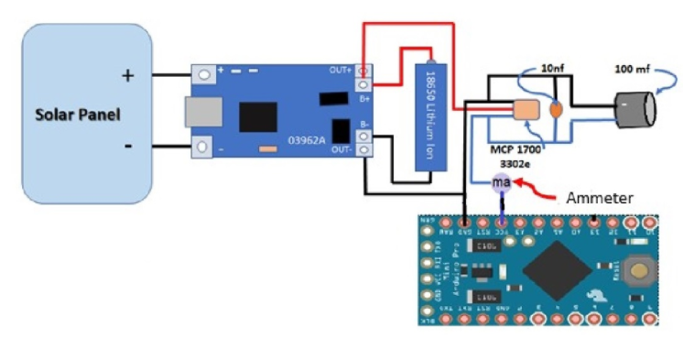
Solar Charging configuration
Charges battery
Supplies power to circuit when solar is producing enough energy
Charge circuit disconnects at night and the battery takes over as power source
Lithium-Ion batteries can be connected in parallel if both batteries are identical

Slide 13
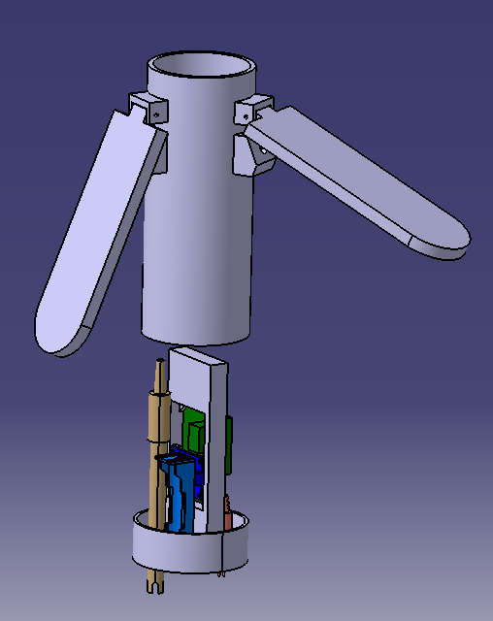
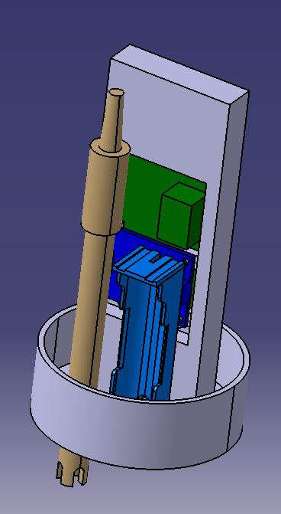
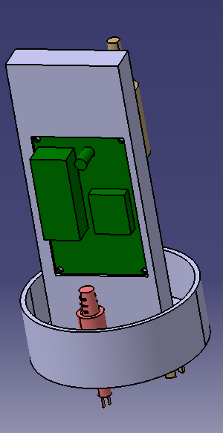
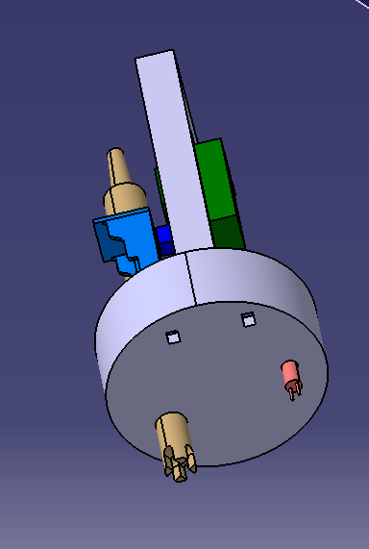
Model Updates

Slide 14
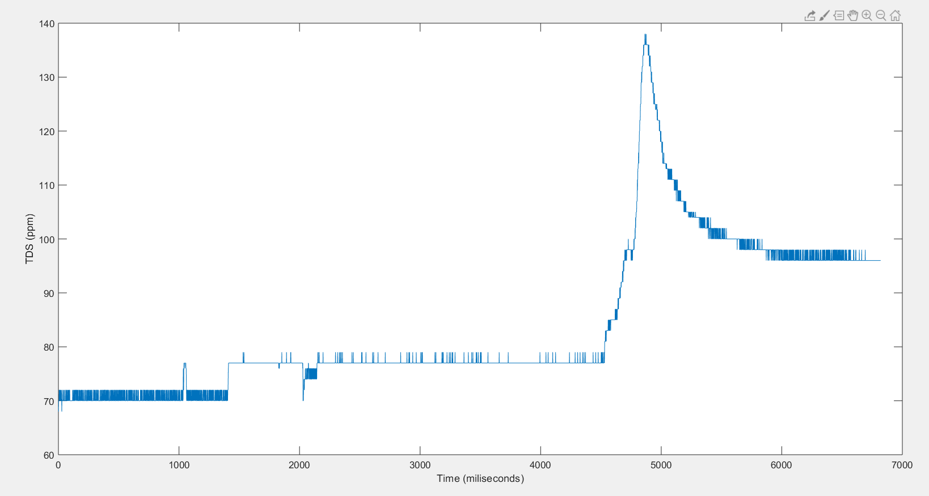
TDS salt experiment

Slide 15
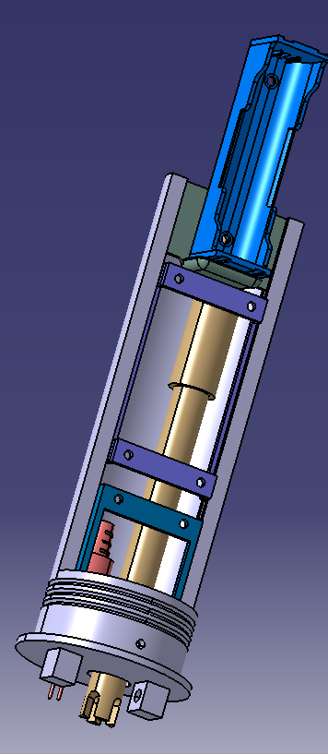
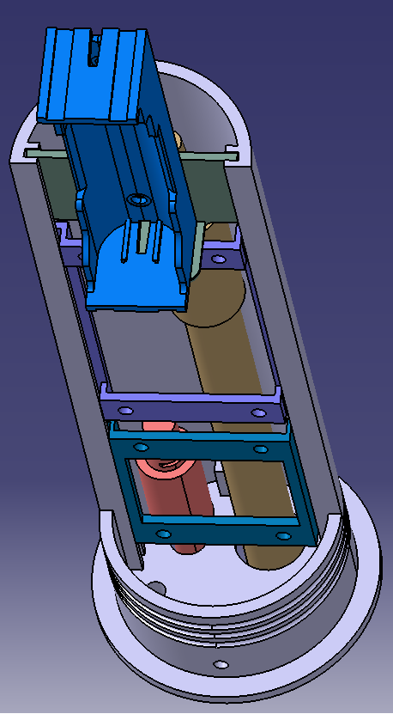
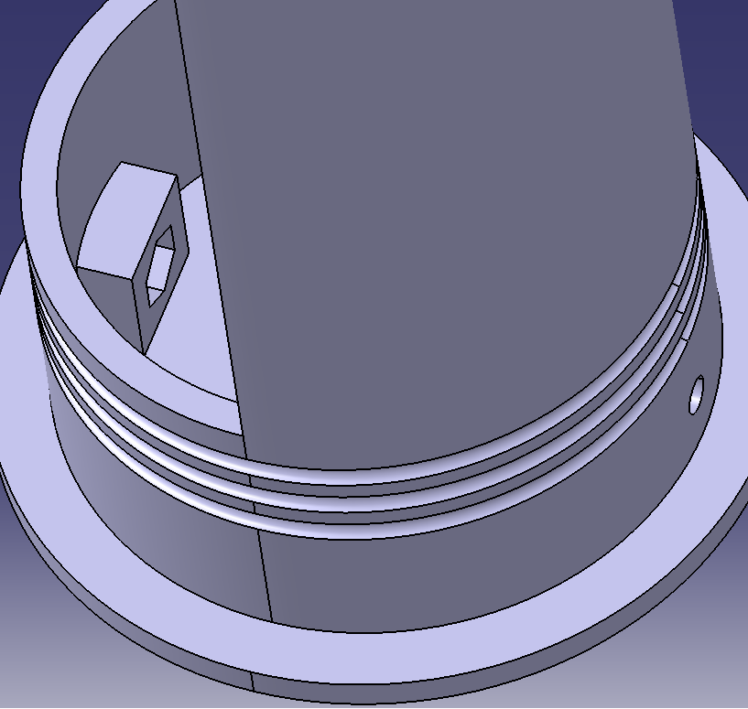
Updated Component Tray

Slide 16
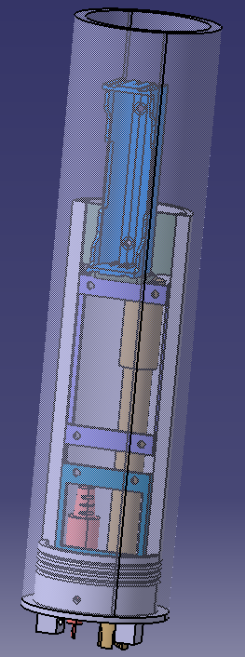

Slide 17
3/15/2022
Updates:
Redesigned component holder
Redesigned water proof solar panel petal holder and cap
Test fit components in the component holder
Collected parts for solar charging
Goals:
Create initial standalone solar battery charger

Slide 18
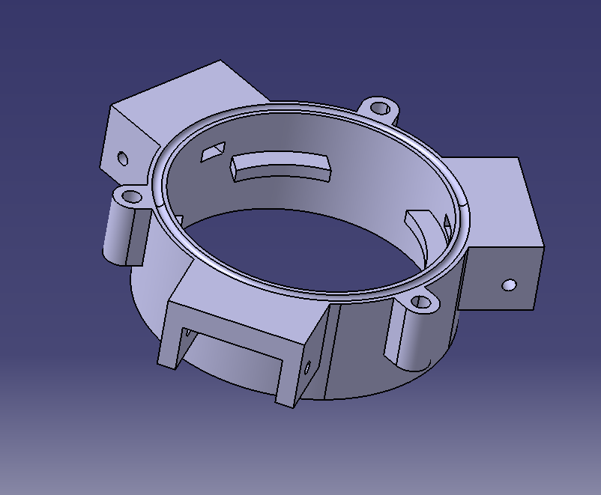
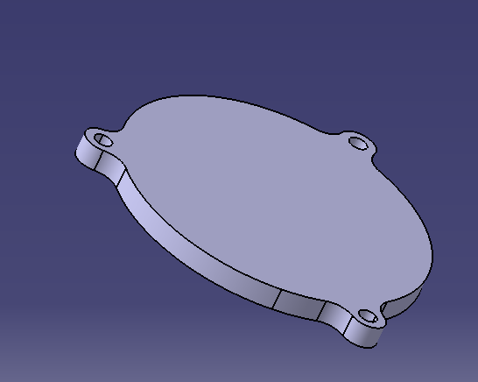
Solar panel holder and Top Cap

Slide 19
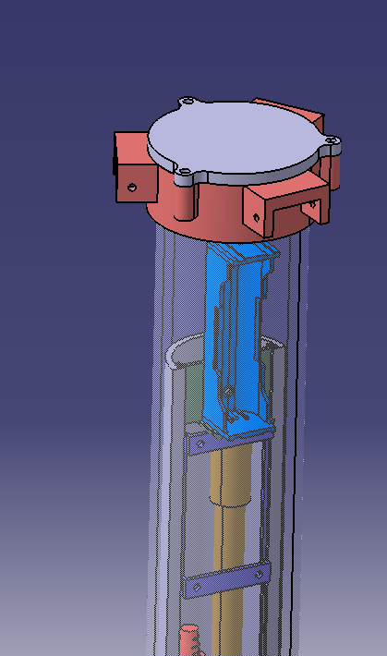
Assembly

Slide 20
3/29/2022 Solar Update
Current and voltage reading from solar panel
Current and voltage reading from solar panel with voltage step down
Current and voltage reading from solar panel with voltage step down and bms
Reviewing Daniels design

Slide 21
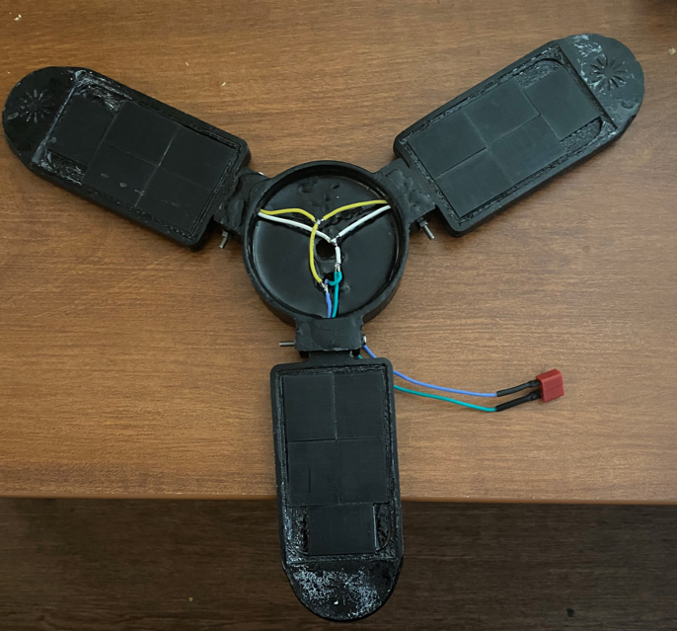
solar panels
Voltage : 16V
Current : 40mA

Slide 22
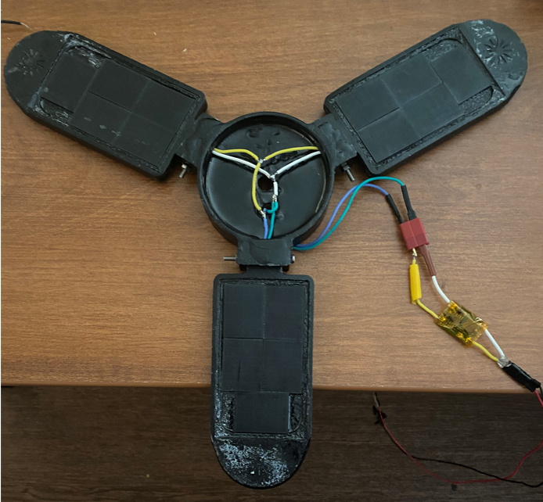
Solar panels with voltage step down
Voltage : 5V
Current : 160mA

Slide 23
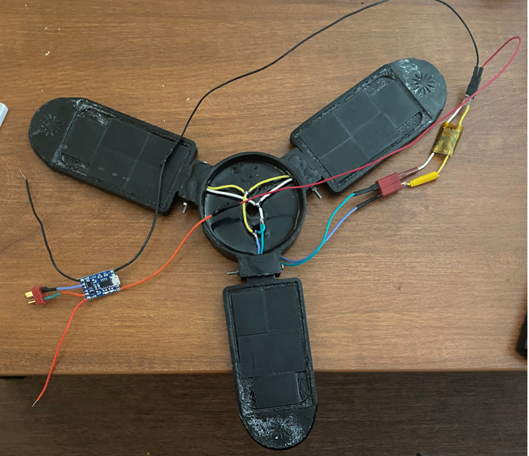
Solar panels with voltage step down and BMS
Voltage : 4.2V
Current : 33mA

Slide 24
Wiring for panels
+
-
-
-
+
+
-
-
+
+

Slide 25
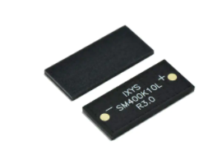
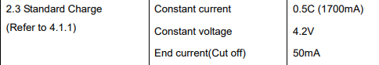
Individual Solar Cell Information
18 cells in parallel
Voltage : 8.29V
Current : 378mA
Battery Specs
Individual Cells Specs
Power : 132.3mW
Voltage : 8.29 V
Current : 21 mA
Would need 42 cells to achieve standard charge rate

Slide 26
4/5/2022
New updates
Removed solar panels from epoxy to resolder and test
Pulled information on package power consumption
Future plans
Run test on fully charged 18650 to set a baseline for how long it will sustain the package for
Run test with solar charging added to see the impact it has on battery life
Design a probe protector for the bottom of the package
Create probe mounting cap out of PVC
Waterproof the 3D printed solar panel flap holder or make it out of solid plastic as well
Make the cap to the solar flap holder out of metal

Slide 27
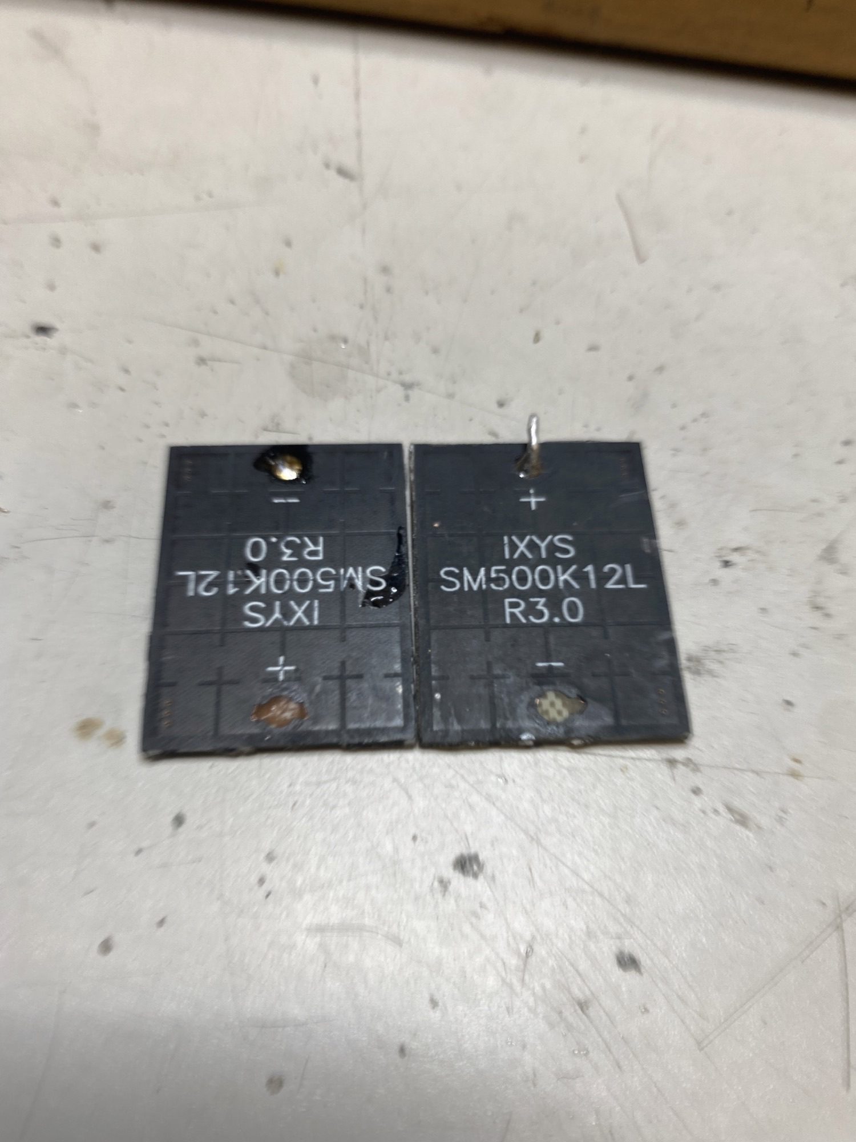
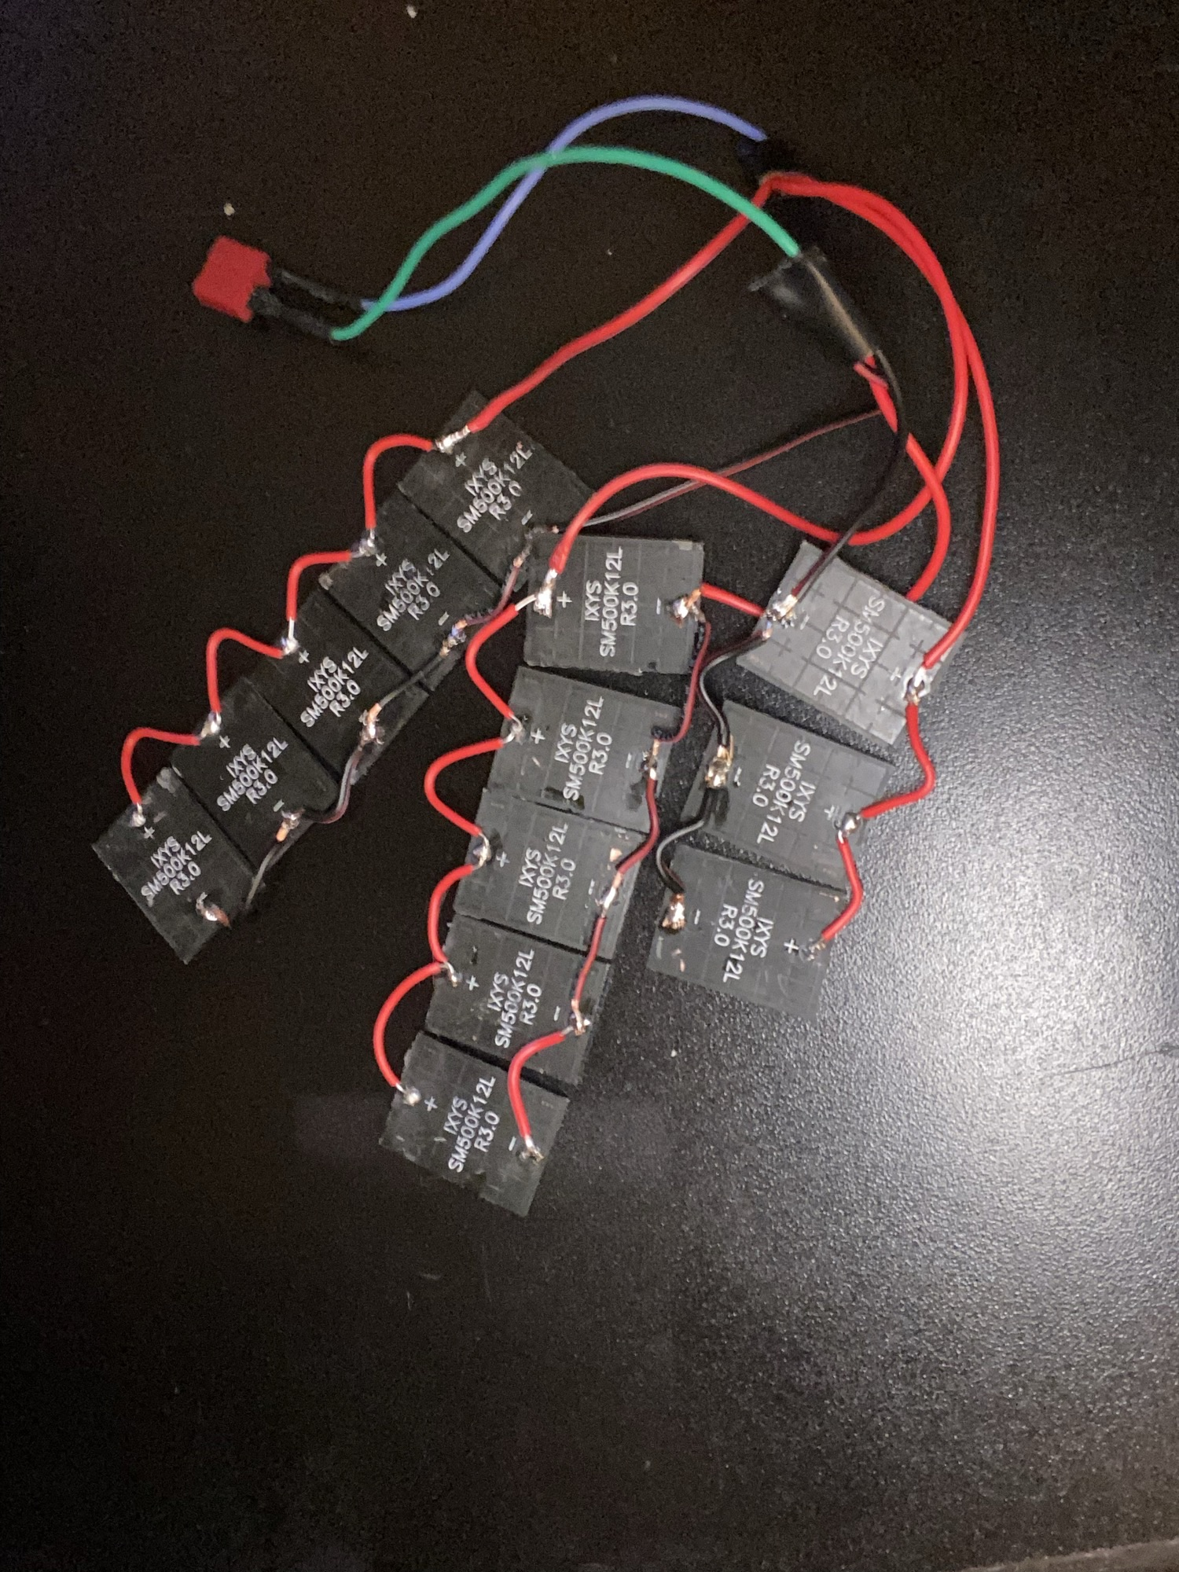
Solar cells
2 cells were damaged while removing from epoxy and cannot be used
The remaining cells were wired in parallel and produce 7.4V and 157mA
Arudino nano power consumption: 19mA
TDS power consumption: 3 – 6mA
Ph power consumption: 3 mA

Slide 28
4/12/2022
New updates
Solar charging circuit has been soldered together with connectors
Future plans
Run test on fully charged 18650 to set a baseline for how long it will sustain the package for
Run test with solar charging added to see the impact it has on battery life
Design a probe protector for the bottom of the package
Create probe mounting cap out of PVC
Waterproof the 3D printed solar panel flap holder or make it out of solid plastic as well
Add metal piece to the solar cap for magnet
Add in Air tag holder to solar cap
Redesign solar flap for new solar panel arrangment

Slide 29
Thanks!
Name
Title
Email
Social

